Slide 1
Forest Park Southeast, Botanical Heights, Central West End, Medical Campus
Washington University Medical Center

Slide 2
Summary Notes: FPSE August 2019
## [1] "20 total crimes in August 2019"
## [1] "11.1% change compared to August 2018 (18 total crimes)"
## [1] "1 crime(s) against persons in August 2019"
## [1] "-75.0% change compared to August 2018 (4 crimes against persons)"
## [1] "166 total crimes in 2019"
## [1] "25.8% change compared to this time in 2018 (132 total crimes)"
## [1] "27 crime(s) against persons in 2019"
## [1] "-20.6% change compared to this time in 2018 (34 crimes against persons)"

Slide 3
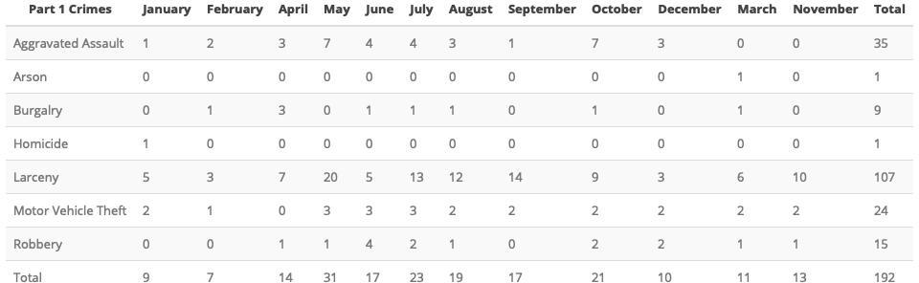
Comparing 2018 to 2019: Forest Park Southeast

Slide 4
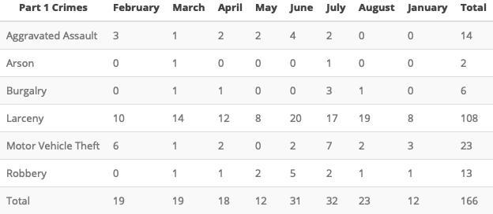

Slide 5
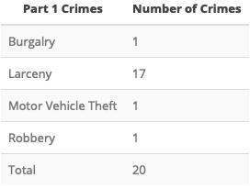
Forest Park Southeast: August 2019

Slide 6
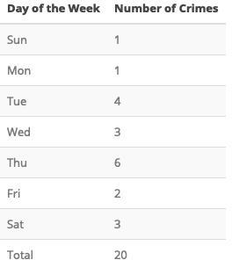

Slide 7
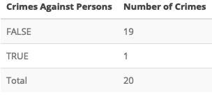

Slide 8
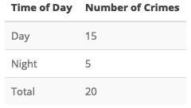

Slide 9
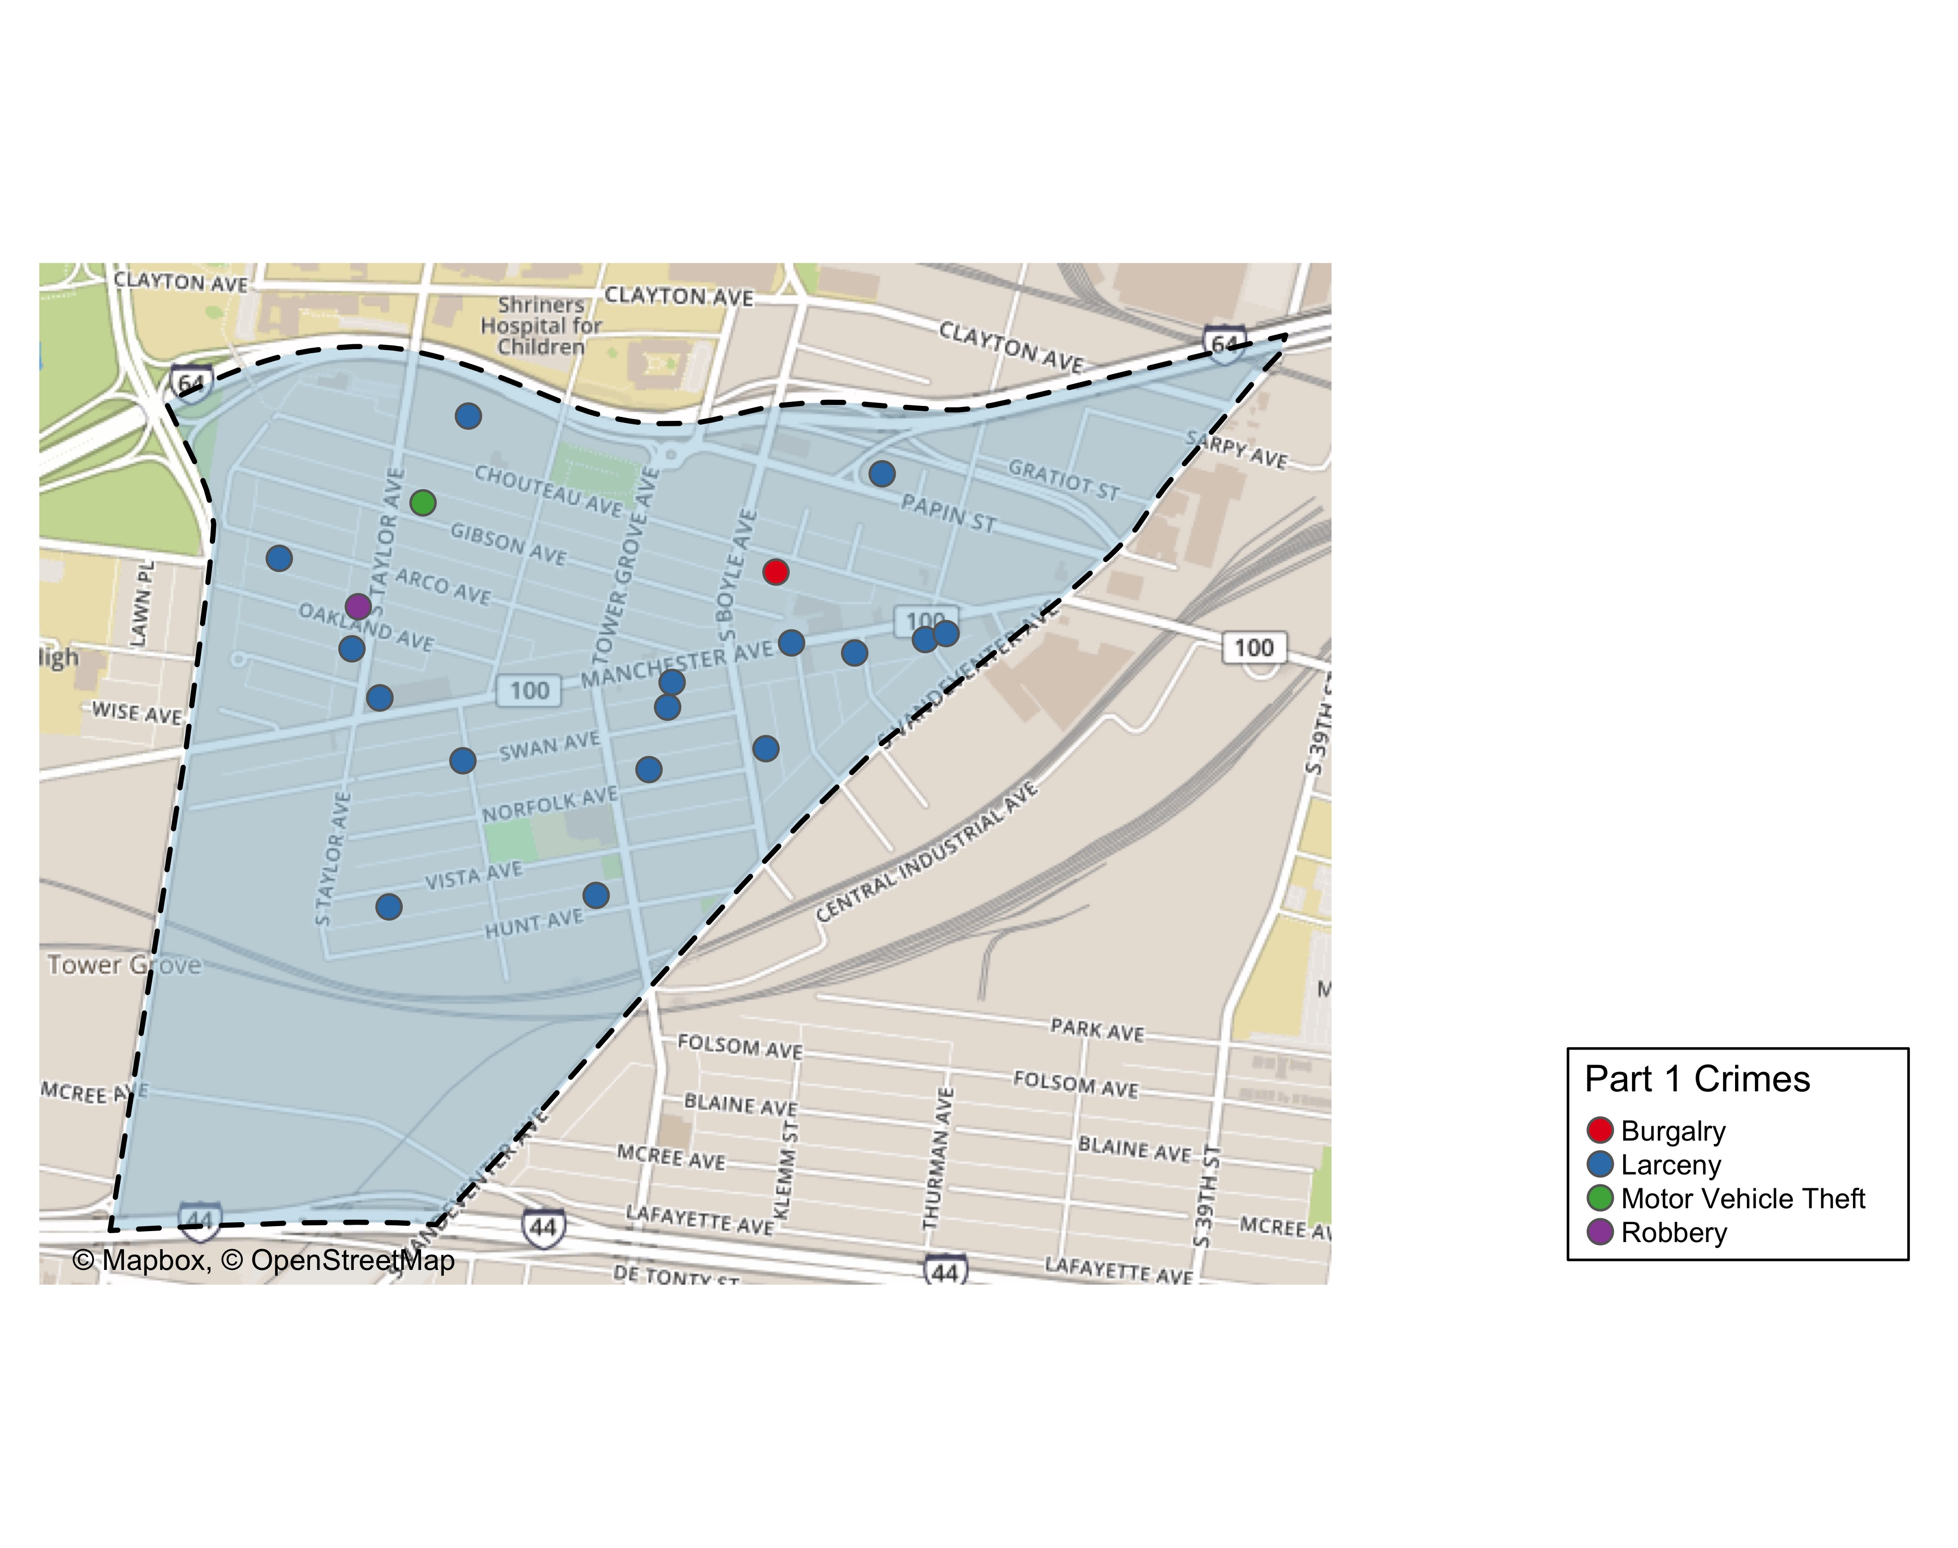
Forest Park Southeast Total Crime

Slide 10
Summary Notes: Botanical Heights
## [1] "4 total crimes in August 2019"
## [1] "-77.8% change compared to August 2018 (18 total crimes)"
## [1] "1 crime(s) against persons in August 2019"
## [1] "0% change compared to August 2018 (1 crimes against persons)"
## [1] "53 total crimes in 2019"
## [1] "-32.1% change compared to this time in 2018 (78 total crimes)"
## [1] "9 crime(s) against persons in 2019"
## [1] "28.6% change compared to this time in 2018 (7 crimes against persons)"

Slide 11
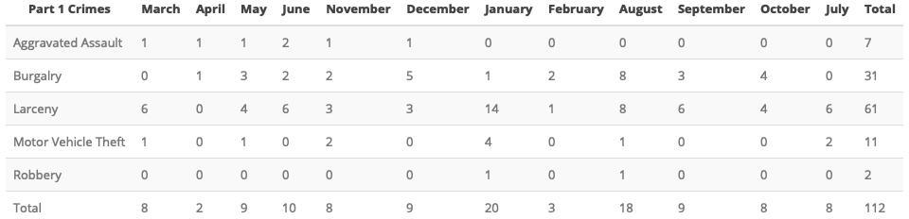
Comparing 2018 to 2019: Botanical Heights

Slide 12
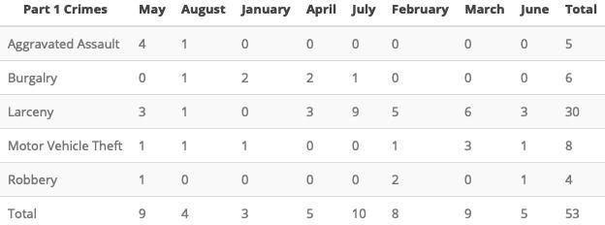

Slide 13
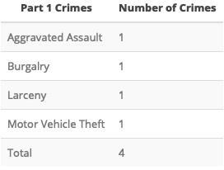

Slide 14
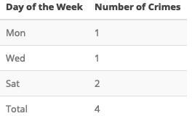

Slide 15
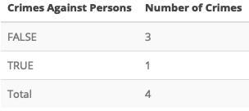

Slide 16
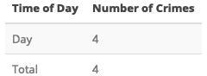

Slide 17
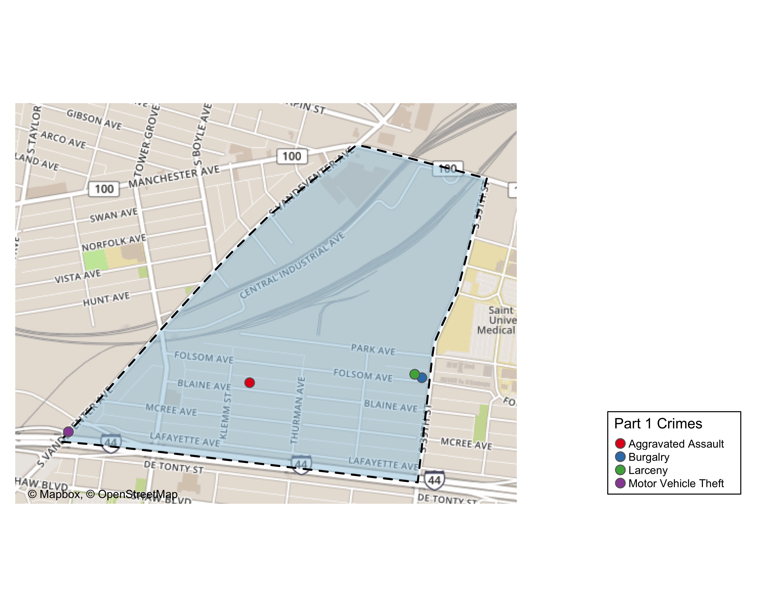
Botanical Heights Total Crime

Slide 18
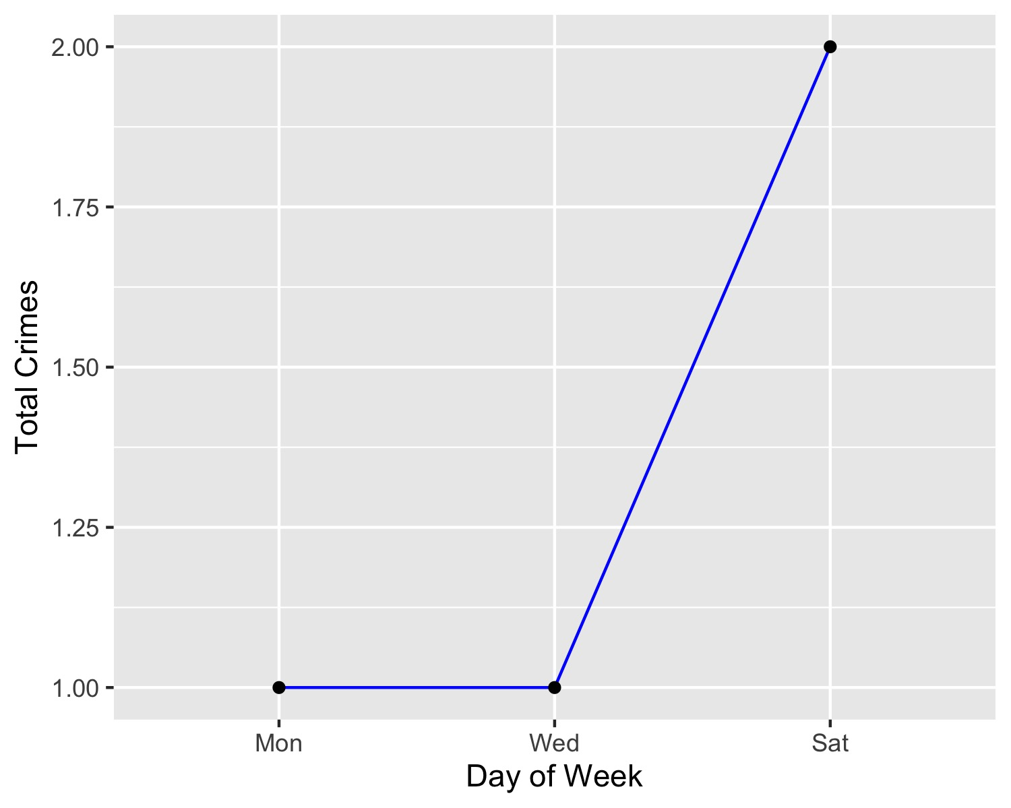
Botanical Heights Crime by Days of the Week

Slide 19
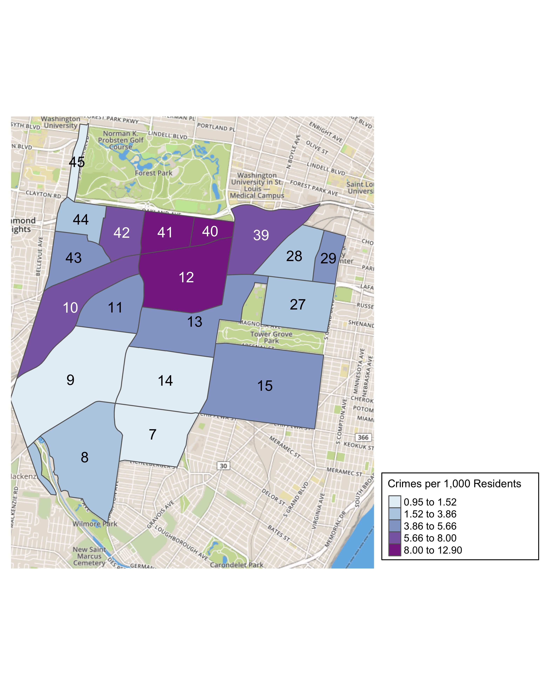
District 2 Crime Rates

Slide 20
District 2 Density Map Explanation
There are 23 neighborhoods in District 2. The South Hampton neighborhood is split between District 2 and District 1.
## [1] "The minimum number of crimes in one neighborhood was 1 (Wydown Skinker)"
## [1] "The maximum number of crimes in one neighborhood was 72 (Tower Grove South)"
## [1] "The mean number of crimes in one neighborhood was 15.95"
## [1] "The minimum rate of crimes in one neighborhood was 0.95 (Wydown Skinker)"
## [1] "The maximum rate of crimes in one neighborhood was 12.9 (Cheltenham)"
## [1] "The mean rate of crimes in one neighborhood was 5.28"

Slide 21
Summary Notes: Central West End
## [1] "121 total crimes in August 2019"
## [1] "0% change compared to August 2018 (121 total crimes)"
## [1] "18 crime(s) against persons in August 2019"
## [1] "38.5% change compared to August 2018 (13 crimes against persons)"
## [1] "770 total crimes in 2019"
## [1] "-8.33% change compared to this time in 2018 (840 total crimes)"
## [1] "101 crime(s) against persons in 2019"
## [1] "17.4% change compared to this time in 2018 (86 crimes against persons)"

Slide 22
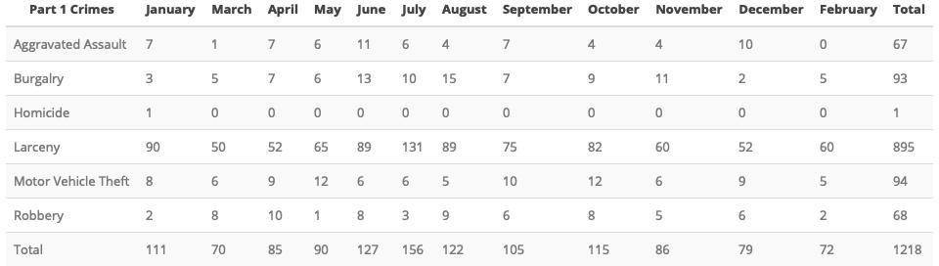
Comparing 2018 to 2019: Central West End

Slide 23
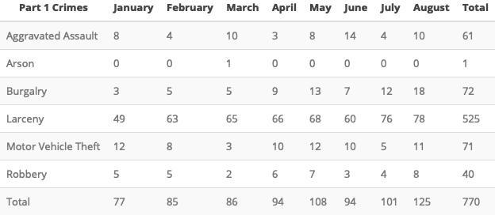

Slide 24
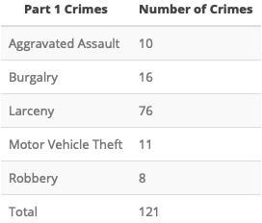
Central West End: August 2019

Slide 25


Slide 26
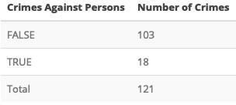

Slide 27
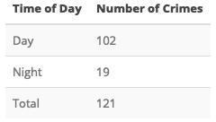

Slide 28
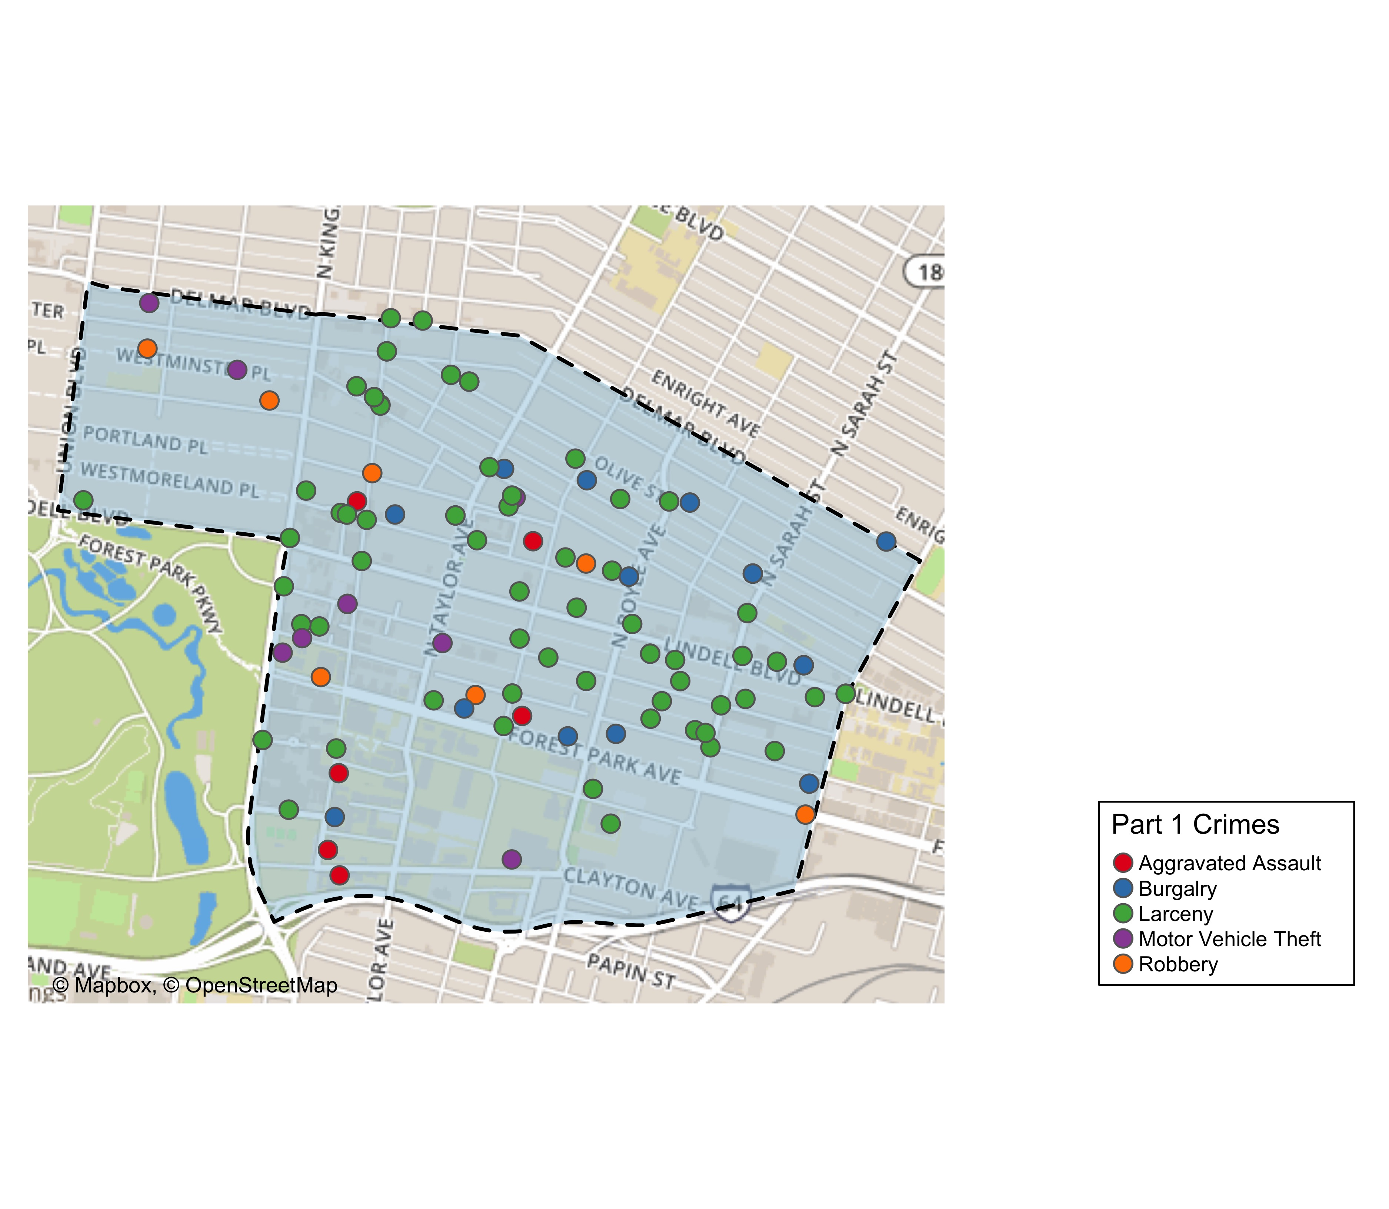
Central West End Total Crime

Slide 29
Washington University Medical Campus: August 2019
## [1] "12 total crimes in August 2019"
## [1] "200% change compared to August 2018 (4 total crimes)"
## [1] "6 crime(s) against persons in August 2019"
## [1] "Inf change compared to August 2018 (0 crimes against persons)"
## [1] "84 total crimes in 2019"
## [1] "25.4% change compared to this time in 2018 (67 total crimes)"
## [1] "16 crime(s) against persons in 2019"
## [1] "129% change compared to this time in 2018 (7 crimes against persons)"

Slide 30
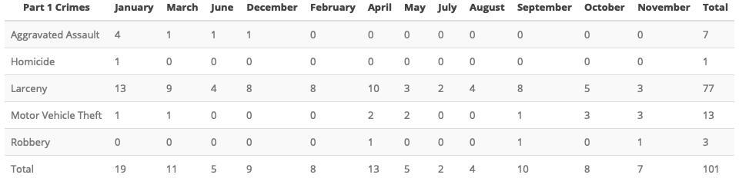
WUMC Campus: Comparing 2018 and 2019

Slide 31
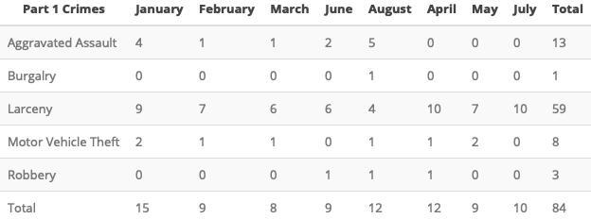

Slide 32
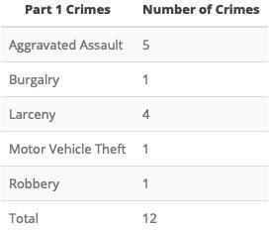
WUMC Campus: August 2019

Slide 33
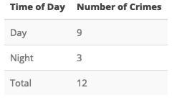

Slide 34
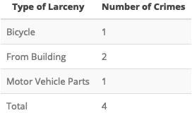

Slide 35
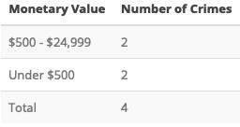

Slide 36
Med. Campus Total Crime: August 2019
cwe_mc_tm <- tm_shape(mc_tiles) + tm_rgb() + nhoods_sf %>% filter(., neighborhood == 38) %>% tm_shape() + tm_borders(col = "black", lwd = 2, lty = "dashed") + tm_shape(med_campus) + tm_fill(col = "#9ecae1", alpha = .5) + tm_borders(col = "black", lwd = 1, lty = "solid") + tm_shape(mc_crimes_month19_sf) + tm_bubbles(size = .25, col = "crimeCatName", palette = "Set1", title.col = "Part 1 Crimes") + tm_credits("© Mapbox, © OpenStreetMap", position = c("left", "BOTTOM")) + tm_layout( frame = FALSE, legend.bg.color = "white", legend.frame=TRUE, legend.outside = TRUE, legend.position = c("right", "bottom")) tmap_save(cwe_mc_tm, file = here("results/cwe/2019/august/mc_total_crimes.jpeg"), dpi = 500)
## Map saved to /Users/jesstevens/Documents/professional/wumcrc/safety-and-security/r-crime-mapping/results/cwe/2019/august/mc_total_crimes.jpeg
## Resolution: 3837.59 by 3192.108 pixels
## Size: 7.675179 by 6.384216 inches (500 dpi)

Slide 37
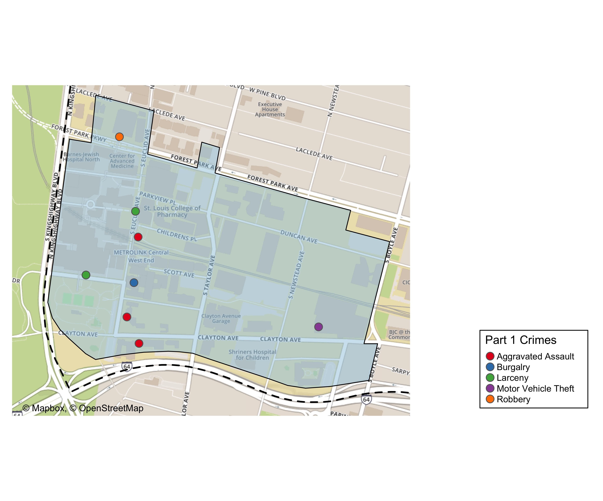

Slide 38
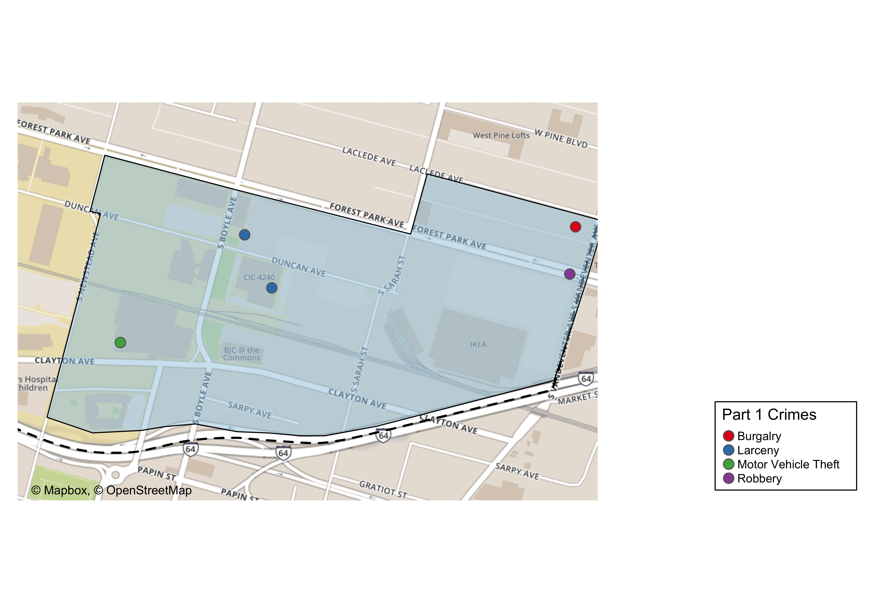
Cortex Total Crimes

Slide 39
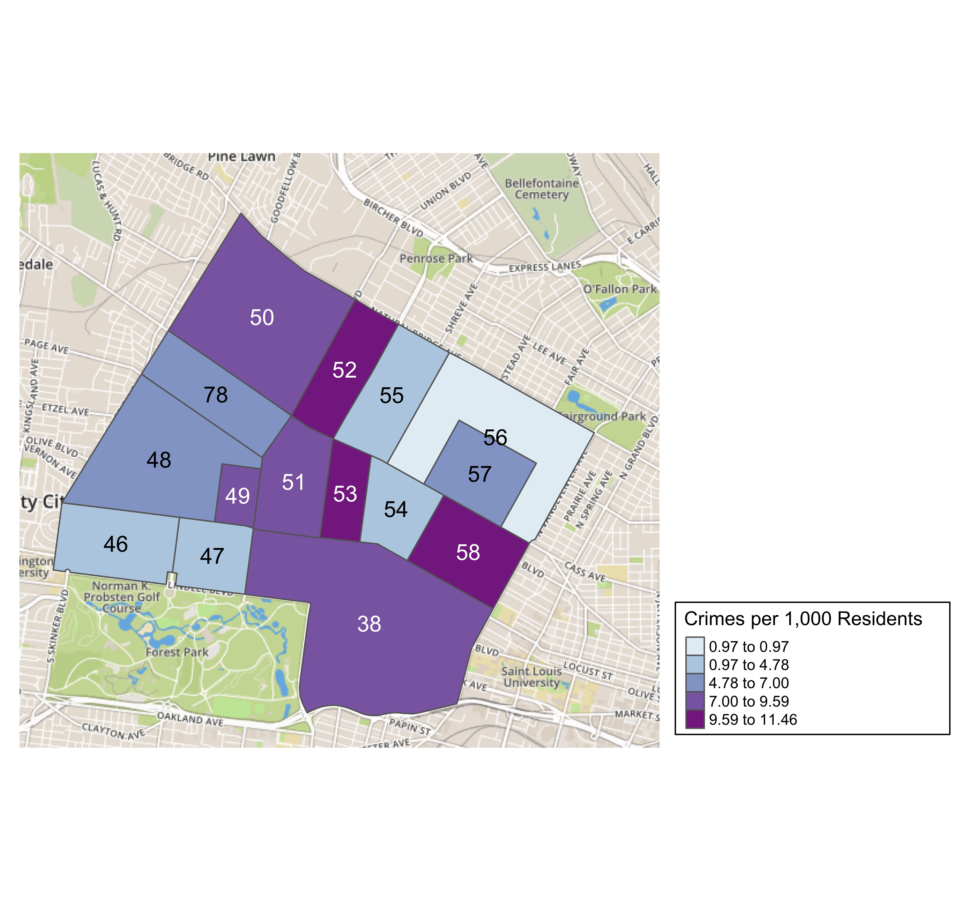
District 5 Crime Rates

Slide 40
District 5 Density Map Explanation
There are 23 neighborhoods in District 5. The South Hampton neighborhood is split between District 2 and District 1.
## [1] "The minimum number of crimes in one neighborhood was 6 (Greater Ville)"
## [1] "The maximum number of crimes in one neighborhood was 121 (Central West End)"
## [1] "The mean number of crimes in one neighborhood was 27.27"
## [1] "The minimum rate of crimes in one neighborhood was 0.97 (Greater Ville)"
## [1] "The maximum rate of crimes in one neighborhood was 11.46 (Fountain Park)"
## [1] "The mean rate of crimes in one neighborhood was 7.02"

Slide 41
FPSE Larceny

